Slide 1

Amazon Sales Analysis-2025
Using MS-Excel
Presentation Slides
Presented by:
Sanjoy Dutta

Slide 2


Business Objective
Objective of the Analysis
Analyze Amazon India sales performance for 2025
Identify top-performing categories, products, and states
Evaluate customer satisfaction and return behavior
Support data-driven business and operational decisions

Slide 3
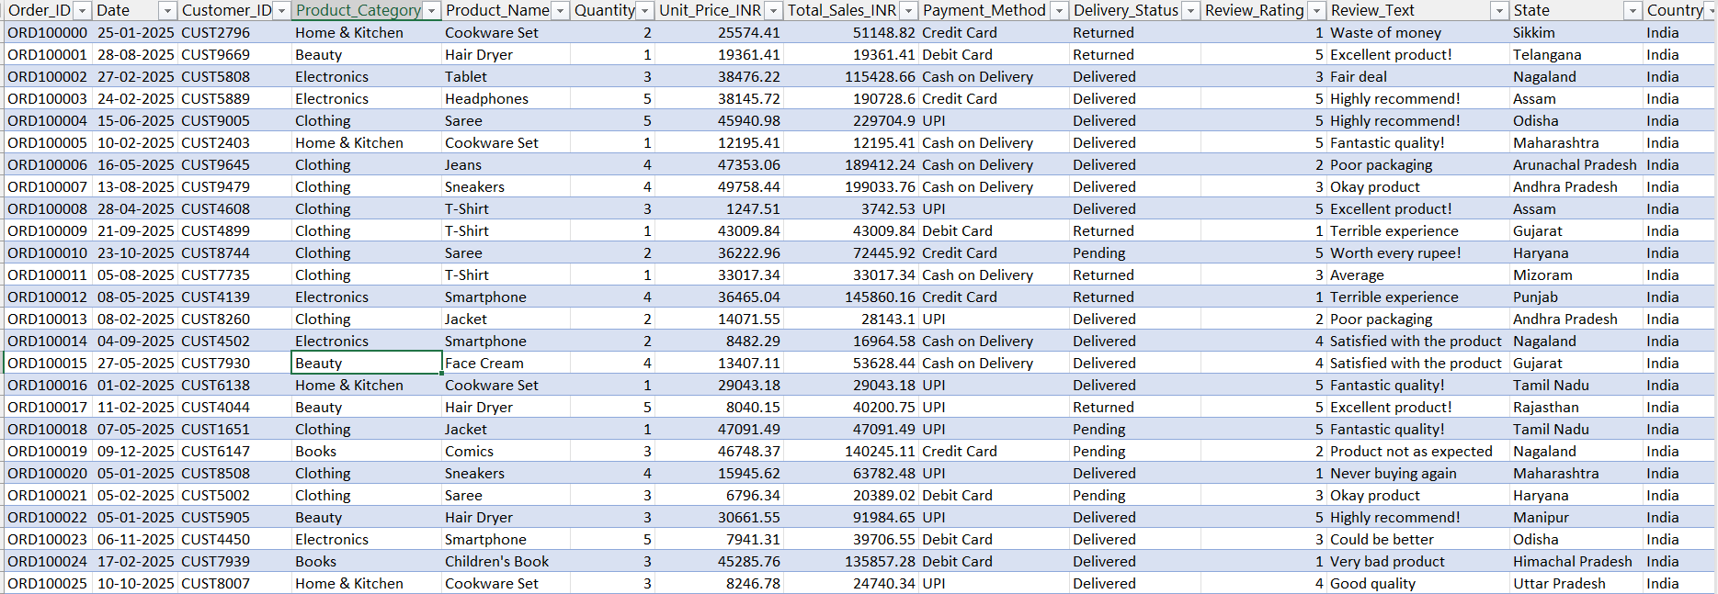
Dataset Overview
Dataset Summary
Orders, products, revenue, payments, delivery & reviews
Key fields:
Order Date, Product Category, Sales (₹)
Payment Method & Delivery Status
Customer Ratings & Reviews
State-wise sales data
Time Period: 2025 Market: Amazon India

Slide 4
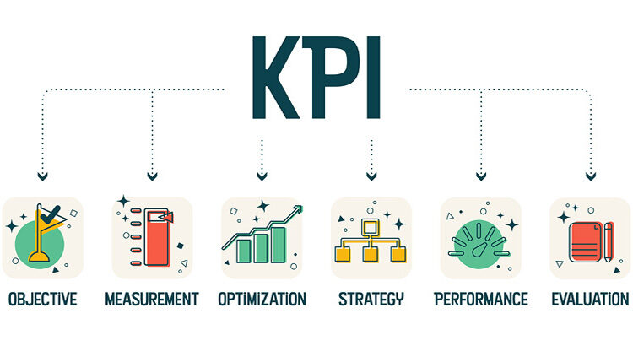
Key Performance Indicators
Overall Performance Snapshot
Total Sales: ₹1,118M
Total Orders: 15K
Average Order Value: ₹75K
Return Rate: 33%
Average Customer Rating: 3.0
KPIs dynamically update using slicers.

Slide 5
Sales Performance Insights
Revenue Analysis
Books and Electronics are the highest revenue-generating categories
Home & Kitchen shows lowest revenue contribution
Sales remain relatively stable across months with minor fluctuations
Business Insight: Focus on high-performing categories while improving weaker segments.

Slide 6
Customer Experience Analysis
Ratings & Returns
Average rating across categories is around 3.0
Electronics and Clothing show higher return volumes
Lower ratings are strongly associated with returned orders
Business Insight: Product quality and customer expectations need improvement in high-return categories.

Slide 7
Payment & Operational Insights
Payment Behavior
Credit Card and Cash on Delivery generate the highest revenue
UPI shows strong adoption among customers
Delivery Status
Majority of orders are successfully delivered
Returned orders contribute significantly to operational loss

Slide 8
Geographic Performance
Top States by Revenue
Bihar, West Bengal, Uttar Pradesh lead in sales
Some high-revenue states show average to low ratings
Business Insight: Regional logistics and service quality can be optimized to improve satisfaction.

Slide 9
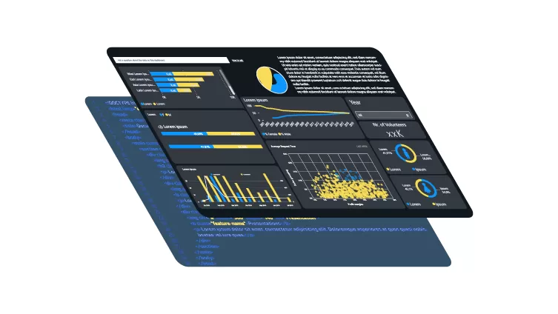
Dashboard Features
Interactive Dashboard Highlights
Dynamic KPIs connected with slicers
Filters by:
State
Product Category
Payment Method
Month
Enables quick comparison and drill-down analysis

Slide 10

Key Recommendations
Actionable Insights
Reduce returns by improving product quality and packaging
Promote high-rating but low-sales products
Strengthen logistics in low-rating high-sales states
Encourage digital payments to reduce return risk

Slide 11

Tools & Skills Used
Tools
MS Excel
Pivot Tables & Pivot Charts
Slicers & Timelines
PowerPoint
Skills
Data Analysis
Dashboard Design
Business Insights
Data Visualization

Slide 12

Conclusion
Conclusion
The dashboard provides a 360° view of sales, customers, and operations
Helps stakeholders make informed, data-driven decisions
Can be extended with advanced analytics or Power BI integration

Slide 13


Thank You
Sanjoy Dutta
E : sandutta2000@gmail.com

